Slide 1
Rekayasa Perangkat LUnak
Lecturer Team for Even Semester Year 2019-2020:
Hetti Hidayati
Reza Budiawan
Only for academic purpose at Diploma of Application of Software Engineering, School of Applied Science, Telkom University

Slide 2
Rules
Presence’s Tapping:
At the beginning
After 1 hour of the class
Tardiness tolerance: 15 minutes
Uniform rule: based on Tel-U’s rule about uniform
Total minimal presences: 75%
There is a quiz for every meeting except for assessment or presentation schedule’s meeting.
All acts of cheating will get an E grade

Slide 3
Resources

Slide 4
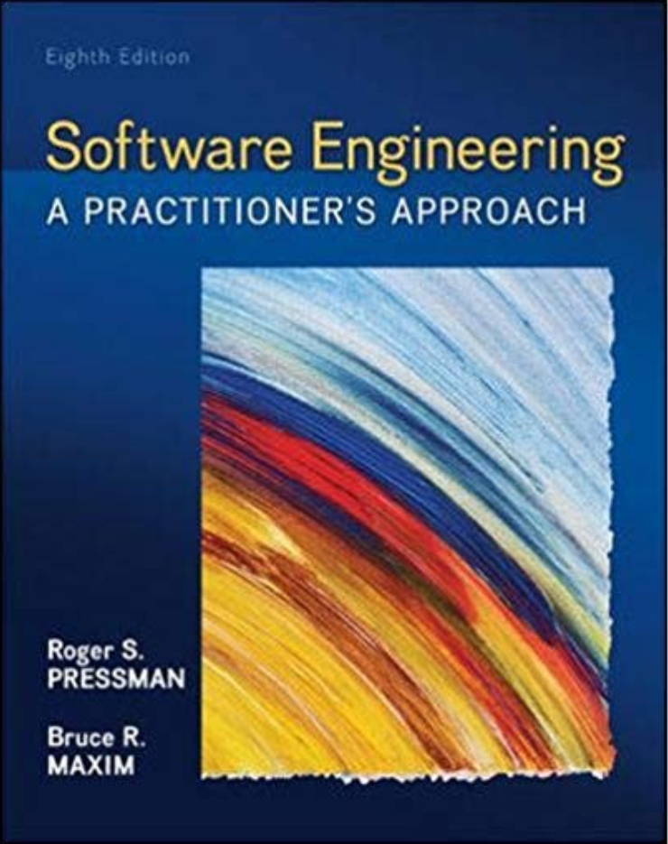
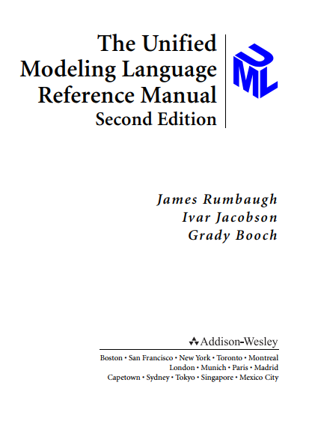

Slide 5
Theory
1 x 50 minutes

Slide 6
Agile Development
Value of Agile Development

Slide 7
Agile Value Manifesto
Individuals and interactions over processes and tools
Working software over comprehensive documentation
Customer collaboration over contract negotiation
Responding to change over following a plan

Slide 8
Definition
Agile software engineering combines a philosophy and a set of development guidelines.
The philosophy encourages customer satisfaction and early incremental delivery of software; small, highly motivated project teams; informal methods; minimal software engineering work products; and overall development simplicity.
The development guidelines stress delivery over analysis and design (although these activities are not discouraged), and active and continuous communication between developers and customers.

Slide 9
Definition
Agile software engineering represents a reasonable alternative to conventional software engineering for certain classes of software and certain types of software projects. It has been demonstrated to deliver successful systems quickly.
Agile development might best be termed “software engineering lite.” The basic framework activities— communication, planning, modeling, construction, and deployment—remain
The activities morph into a minimal task set that pushes the project team toward construction and delivery (some would argue that this is done at the expense of problem analysis and solution design).

Slide 10
Definition
In essence, agile methods were developed in an effort to overcome perceived and actual weaknesses in conventional software engineering. Agile development can provide important beneﬁts, but it is not applicable to all projects, all products, all people, and all situations.

Slide 11
Why Agile?
In the modern economy, it is often difﬁ cult or impossible to predict how a computer-based system (e.g., a mobile application) will evolve as time passes.
The prescriptive process models have a major failing: they forget the frailties of the people who build computer software.
Software engineers are not robots. They exhibit great variation in working styles; signiﬁcant differences in skill level, creativity, orderliness, consistency, and spontaneity.
If process models are to work, they must provide a realistic mechanism for encouraging the discipline that is necessary, or they must be characterized in a manner that shows “tolerance” for the people who do software engineering work.
One of the most compelling characteristics of the agile approach is its ability to reduce the costs of change through the software process.

Slide 12
What is Agility?
An agile team is a nimble team able to appropriately respond to changes. Change is what software development is very much about
Support for changes should be built-in everything we do in software, something we embrace because it is the heart and soul of software.
An agile team recognizes that software is developed by individuals working in teams and that the skills of these people, their ability to collaborate is at the core for the success of the project.
Agility is more than an effective response to change. It also encompasses the philosophy espoused in the manifesto:

Slide 13
Agile Value Manifesto
Individuals and interactions over processes and tools
Working software over comprehensive documentation
Customer collaboration over contract negotiation
Responding to change over following a plan

Slide 14
Agility Characteristic
It emphasizes rapid delivery of operational software and deemphasizes the importance of intermediate work products (not always a good thing);
it adopts the customer as a part of the development team and works to eliminate the “us and them” attitude that continues to pervade many software projects;
it recognizes that planning in an uncertain world has its limits and that a project plan must be ﬂexible.

Slide 15
Agility Characteristic
Agility can be applied to any software process.
However, to accomplish this, it is essential that the process be designed in a way that allows the project team to adapt tasks and to streamline them, conduct planning in a way that understands the ﬂuidity of an agile development approach, eliminate all but the most essential work products and keep them lean, and emphasize an incremental delivery strategy that gets working software to the customer as rapidly as feasible for the product type and operational environment.

Slide 16
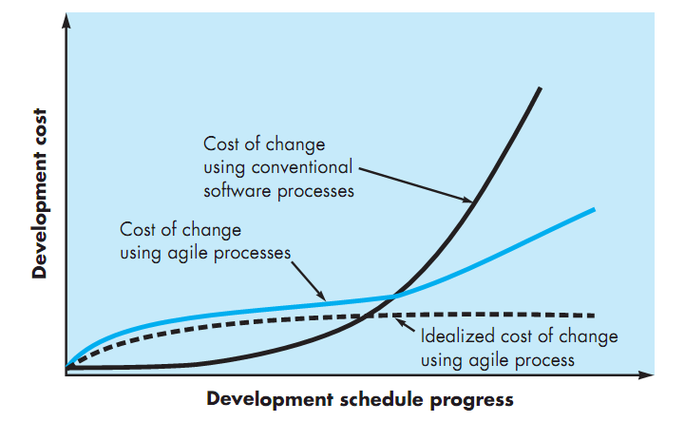
Agility & Cost of Change

Slide 17
Agile Process
Agile Process
Adaptable
Notes:
How do we create a process that can manage unpredictability ? The answer, as we have already
noted, lies in process adaptability (to rapidly changing project and technical conditions). An agile process, therefore, must be adaptable.
But continual adaptation without forward progress accomplishes little.
Therefore, an agile software process must adapt incrementally. To accom-
plish incremental adaptation, an agile team requires customer feedback
so that the appropriate adaptations can be made). An effective catalyst for
customer feedback is an operational prototype or a portion of an operational
system. Hence, an incremental development strategy should be instituted.

Slide 18
12 Agility Principles
Our highest priority is to satisfy the customer through early and continuous delivery of valuable software.
Welcome changing requirements, even late in development. Agile processes harness change for the customer's competitive advantage.
Deliver working software frequently, from a couple of weeks to a couple of months, with a preference to the shorter timescale
Business people and developers must work together daily throughout the project.
Build projects around motivated individuals. Give them the environment and support they need, and trust them to get the job done.
The most efﬁcient and effective method of conveying information to and within a development team is face-to-face conversation.

Slide 19
12 Agility Principles
Working software is the primary measure of progress.
Agile processes promote sustainable development.
Continuous attention to technical excellence and good design enhances agility
Simplicity—the art of maximizing the amount of work not done—is essential
The best architectures, requirements, and designs emerge from self-organizing teams.
At regular intervals, the team reﬂects on how to become more effective, then tunes and adjusts its behavior accordingly.

Slide 20
Agile Process
Extreme Programming

Slide 21
Extreme Programming (XP)
Extreme Programming (XP), the most widely used approach to agile software development.
A variant of XP, called Industrial XP (IXP), reﬁnes XP and targets the agile process speciﬁcally for use within large organizations.

Slide 22
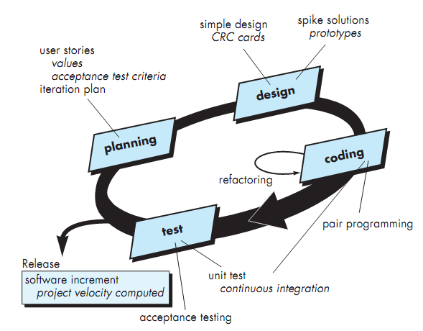
XP Processes
Notes:
Planning. The planning activity (also called the planning game ) begins with listening —a requirements gathering activity that enables the technical members
Listening leads to the creation of a set of “stories”, that describe required output, features, and functionality for software to be built
Design. XP design rigorously follows the KIS (keep it simple) principle. A simple design is always preferred over a more complex representation.
Coding. After stories are developed and preliminary design work is done, the
team does not move to code, but rather develops a series of unit tests that will
exercise each of the stories that is to be included in the current release
Testing. The unit tests that are created should be implemented using a frame-
work that enables them to be automated (hence, they can be executed easily and repeatedly

Slide 23
XP Coding: Pair Programming
A key concept during the coding activity (and one of the most talked-about aspects of XP) is pair programming.
XP recommends that two people work together at one computer workstation to create code for a story. This provides a mechanism for real-time problem solving (two heads are often better than one) and real-time quality assurance (the code is reviewed as it is created).
It also keeps the developers focused on the problem at hand. In practice, each person takes on a slightly different role. For example, one person might think about the coding details of a particular portion of the design while the other ensures that coding standards.

Slide 24
Agile Process
SCRUM

Slide 25
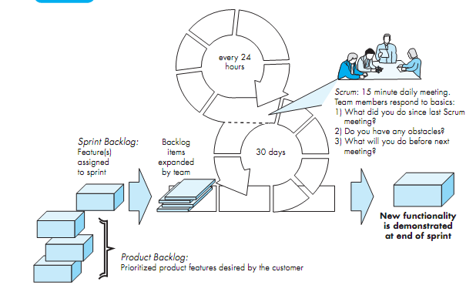

Slide 26
Scrum Process
Scrum is an agile software development method that was conceived by Jeff Sutherland and his development team in the early 1990s.
Scrum principles are consistent with the agile manifesto and are used to guide development activities within a process that incorporates the following frame-work activities: requirements, analysis, design, evolution, and delivery.
Within each framework activity, work tasks occur within a process pattern called a sprint.
Scrum emphasizes the use of a set of software process patterns that have proven effective for projects with tight timelines.

Slide 27
Scrum Activities
Each of these process patterns defines a set of development activities: Backlogs, Sprints, Scrum Meetings
Backlog —a prioritized list of project requirements or features that provide business value for the customer. Items can be added to the backlog at any time.
Sprints —consist of work units that are required to achieve a requirement deﬁned in the backlog that must be ﬁt into a predeﬁned time-box
Scrum meetings —are short (typically 15-minute) meetings held daily by the Scrum team. Three key questions are asked and answered by all team members:
What did you do since the last team meeting?
What obstacles are you encountering?
What do you plan to accomplish by the next team meeting?

Slide 28
Agile Process
Dynamic Systems Development Method

Slide 29
Dynamic Systems Development Method (DSDM)
Dynamic Systems Development Method is an agile software development approach that “provides a framework for building and maintaining systems which meet tight time constraints through the use of incremental prototyping in a controlled project environment.
DSDM is an iterative software process in which each iteration follows the 80 percent rule. That is, only enough work is required for each increment to facilitate movement to the next increment.

Slide 30
DSDM Iterative Cycles
Functional model iteration— produces a set of incremental prototypes that demonstrate functionality for the customer.
Design and build iteration— revisits prototypes built during the functional model iteration to ensure that each has been engineered in a manner that will enable it to provide operational business value for end users
Implementation— places the latest software increment (an “operationalized” prototype) into the operational environment.

Slide 31
Agile Process
Agile Modeling (AM)

Slide 32
Agile Modeling (AM)
Agile Modeling (AM) is a practice-based methodology for effective modeling and documentation of software-based systems.
Agile Modeling (AM) is a collection of values, principles, and practices for modeling software that can be applied on a software development project in an effective and light-weight manner.
Agile models are more effective than traditional models because they are just barely good, they don’t have to be perfect.

Slide 33
Agile Process
Agile Unified Process (AUP)

Slide 34
Agile Unified Process (AUP)
AUP provides a serial overlay that enables a team to visualize the overall process ﬂow for a software project.
Each AUP iteration addresses the following activities:
Modeling. UML representations of the business and problem domains are created.
Implementation. Models are translated into source code.
Testing
Deployment
Conﬁguration and project management.
Environment management.

Slide 35
Quiz Time!!
It changed to preliminary task (TP) – 0 minute

Slide 36
Case study
How to use Trello – 2 x 50 minutes

Slide 37
Agile & Collaboration Task
Agile promotes the profound concept that large projects can be broken down into smaller tasks. They are then completed in manageable chunks and prioritized and iterated on as needed.
Because of its immense benefits to productivity and workflow flexibility, teams from all kinds of industries have embraced the Agile mindset. Product development, marketing, and sales are just some of the activities that can be accelerated and improved with it.
The Agile methodology has been successfully applied with the popular project management tool, Trello. It’s among the top choices for organization software that can accommodate the principles of Agile. Trello is based on the Kanban productivity system.
Notes:
https://blog.hubstaff.com/agile-trello/

Slide 38
Agile & Collaboration Task
As a practice, you can start your own trello, with following this tutorial.
https://elitemarketer.id/content/cara-menggunakan-trello-untuk-mengelola-konten-blog-anda/

Slide 39
Case Study (PRactice)
Collaboration & Agile – 2 x 50 minutes
(Watch the video)
https://www.youtube.com/watch?v=BuZyd9ewflQ

Slide 40
Task
Make a trello board with your friend that adapt agile methodology (scrum) for developing your software
You can adapt this board’s template: https://trello.com/b/6otslC4i/template-board-agile-with-trello
You can make your own imaginary project, or follow the task from “Proyek Tingkat 2”.

